Slide 1
Bookworm Library Interface
By: Jarrod Rotolo, Caleb Leger, Jonathan Hooper

Slide 2
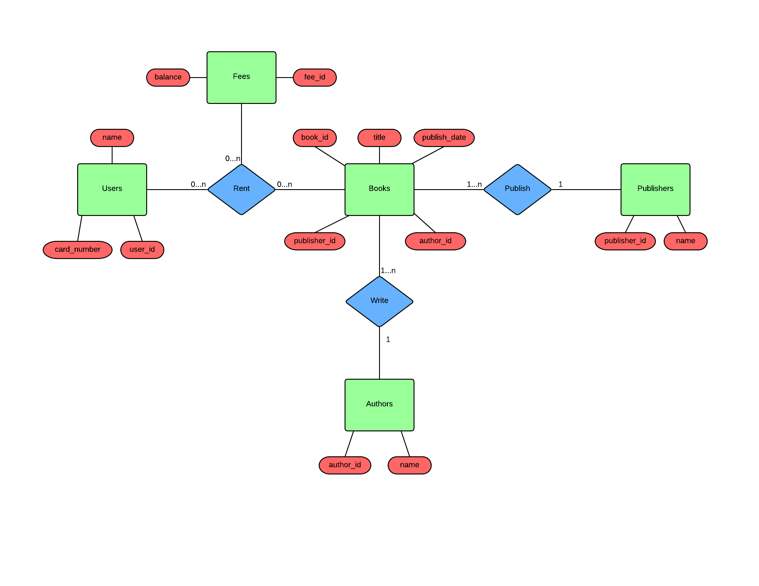
E-R Diagram

Slide 3
Select the users with a fee balance greater than $1
Query :
SELECT user_id, sum(balance) AS total_balance, count(fee_id) AS fee_count
FROM Users NATURAL JOIN Rentals NATURAL JOIN Fees
GROUP BY user_id
HAVING sum(balance) > 100
ORDER BY total_balance DESC;

Slide 4
Select the users with books that are overdue
Query :
SELECT user_id, name, count(rental_id) AS num_overdue_books
FROM Users NATURAL JOIN Rentals
WHERE active = 1 AND CURDATE() > due_date
GROUP BY user_id
ORDER BY num_overdue_books DESC;

Slide 5
Select users with a book checked out by author Alysson Stark
Query :
SELECT DISTINCT user_id, Users.name, book_id, title
FROM Users NATURAL JOIN Rentals NATURAL JOIN Books JOIN Authors ON (Books.author_id = Authors.author_id)
WHERE Authors.name = 'Alysson Stark';

Slide 6
Select all users who have a rental
Query :
SELECT DISTINCT Users.user_id, Users.name
FROM Users NATURAL JOIN Rental;

Slide 7
Select all unique author and publisher pairs
Query :
SELECT r1.author_id, Authors.name as author_name, r1.publisher_id, Publishers.name as publisher_name
FROM (SELECT DISTINCT author_id, publisher_id
FROM Books) as r1, Authors, Publishers
WHERE r1.author_id=Authors.author_id AND r1.publisher_id=Publishers.publisher_id;

Slide 8
Select all users who have checked out a book in the past n days
Query :
SELECT user_id, book_id, checkout_date
FROM Rentals
WHERE datediff(curdate(), checkout_date) <= 7;

Slide 9
Select users with more than 0 fees in order from most fees to least fees
Query :
SELECT user_id, name, COUNT(fee_id) AS fee_count
FROM Users NATURAL JOIN Rentals
GROUP BY user_id
HAVING COUNT(fee_id) > 0
ORDER BY fee_count DESC;

Slide 10
Users the have checked out at least 5 books
Query :
SELECT user_id, name, COUNT(book_id) AS books_rented
FROM Books NATURAL JOIN Rentals NATURAL JOIN Users
GROUP BY user_id
HAVING COUNT(book_id) >= 5
ORDER BY books_rented DESC;

Slide 11
Users that have checked out at more than 1 book by the same author
Query :
SELECT user_id, Users.name AS user_name, Authors.name as author_name, COUNT(book_id) AS books_rented
FROM Books NATURAL JOIN Rentals NATURAL JOIN Users JOIN Authors ON (Books.author_id = Authors.author_id)
GROUP BY user_id, Authors.author_id
HAVING COUNT(book_id) > 1
ORDER BY books_rented DESC;

Slide 12
Books that have never been rented
Query :
SELECT book_id, title, name AS author
FROM Books NATURAL JOIN Authors
WHERE book_id NOT IN
(SELECT book_id FROM Books NATURAL JOIN Rentals);

Slide 13
Select every author that has written a book checked out by user_id = 22
Query :
SELECT DISTINCT Authors.author_id, Authors.name
FROM Authors JOIN Books ON (Books.author_id = Authors.author_id) NATURAL JOIN Rentals JOIN Users ON (Rentals.user_id = Users.user_id)
WHERE Users.user_id = 22;

Slide 14
Change rental from active to inactive
Query :
UPDATE Rentals
SET active = 0
WHERE rental_id = 3;

Slide 15
Change book title
Query :
UPDATE Books
SET title = "Pygmalion"
WHERE title = "Pigmalion";

Slide 16
Change user name
Query :
UPDATE Users
SET name = "John Snow"
WHERE name = "Jon Snow";

Slide 17
Update a fee's balance
Query :
UPDATE Fees
SET balance = 200
WHERE fee_id = 15;

Slide 18
Change rental due date
Query :
UPDATE Rentals
SET due_date = TIMESTAMP '2015-01-01'
WHERE rental_id = 10;

